Slide 1
Predicting the Risk of Heart Disease
Springboard Capstone 2 | Aakash S.

Slide 2
Project Goal
Identify who had or did not have heart disease based of the features in the dataset

Slide 3

Stakeholders
Hospitals
Family
Hospital advising board
Patients

Slide 4
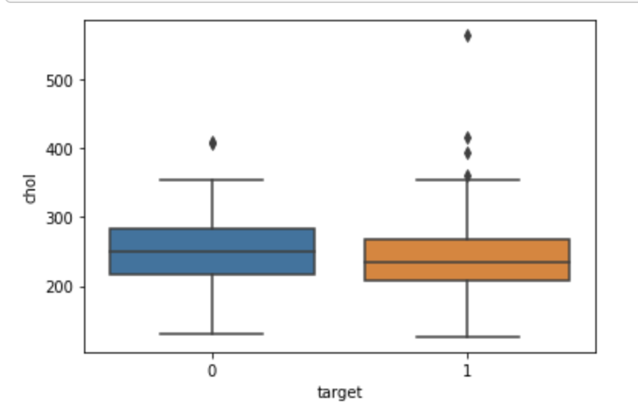
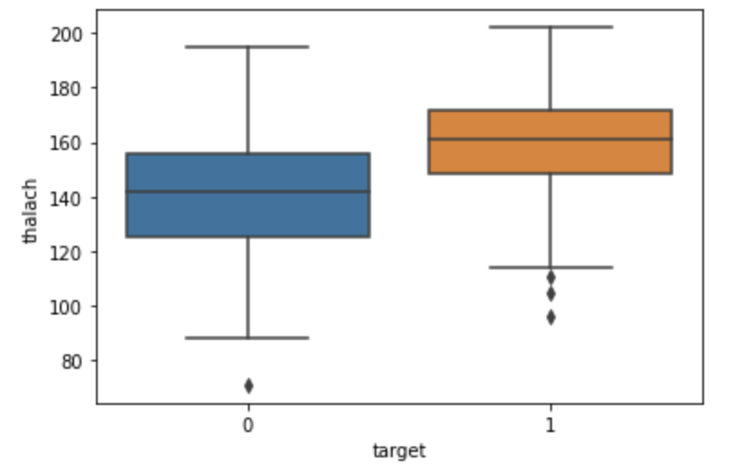
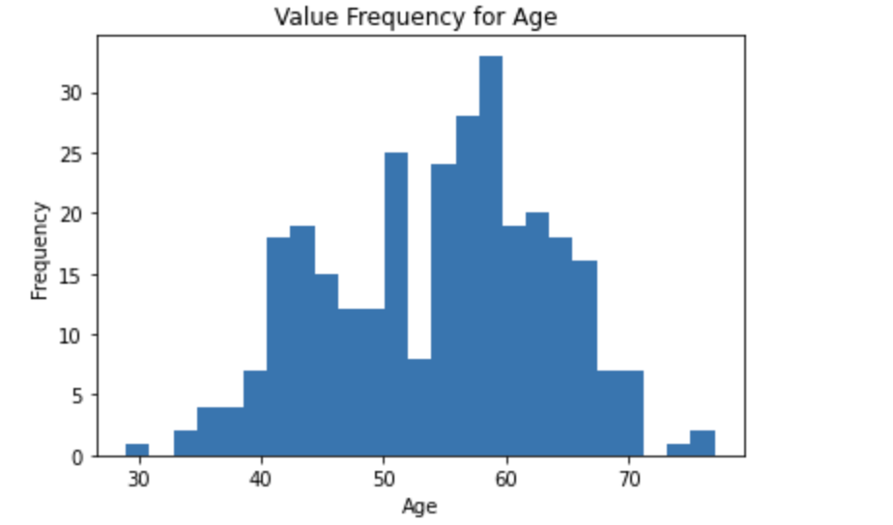
Data Exploration

Slide 5
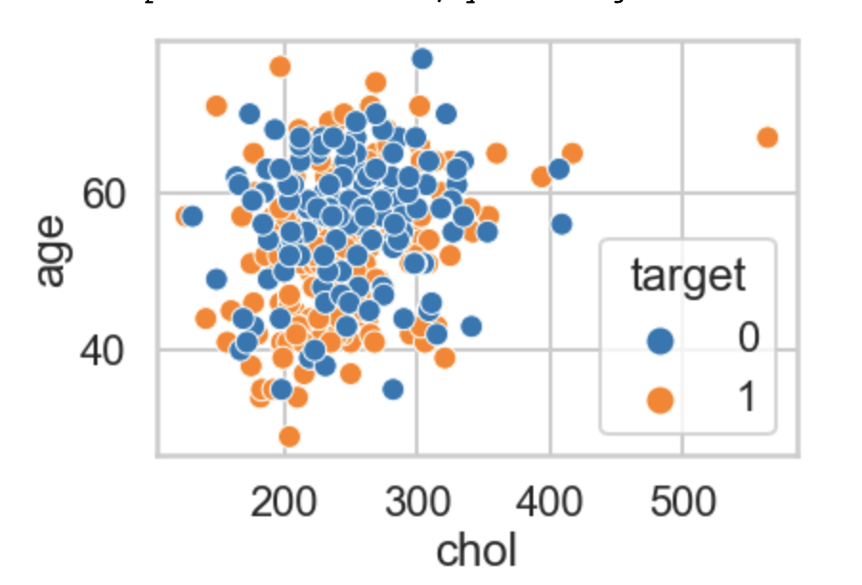
Preprocessing
Correlation of 0( no cholesterol) & 1( with cholesterol)
Average high cholesterol

Slide 6
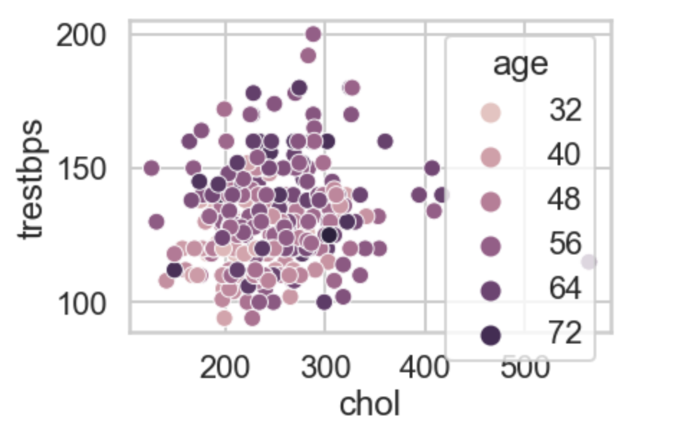
Preprocessing
Comparism between trestbps and cholesterol

Slide 7
Preprocessing & Training
Gradient Boosting :
Learning rate or 1 at a 94% training rate
Random Forest:
Accuracy=0.787
f1-score=0.785

Slide 8
Conclusion
Results from the capstone came to be that overall data resulted in positive computation stating that the overall population of those with heart disease do have the heart disease, especially over the age of 55.

